Slide 1
WEBINAR:
Submitting Time Off Leave Requests and Requesting to Work Overtime or Comp Time
UConn / Core-CT HCM Integration Project
Submitting Time Off Leave Requests and Requesting to Work Overtime or Comp Time

Slide 2
Agenda
Introduction
Demonstrations and Key Takeaways
Submitting a Request for Vacation
Submitting a Request for Sick Time
Submitting a Request to Work Comp Time
Important Information and Resources
Question and Answers

Slide 3
Introduction
Purpose
With the implementation of the Leave and Time Pre-Approval module in Core-CT, University of Connecticut employees will be able to submit self-service requests for time-off leaves and to earn overtime or compensatory time.
Objectives
To provide support, the HCM Project Training Team will employ a multi-faceted training approach for this module, including:
Webinars
Support Labs
Self-Service Job Aids and Reference Materials

Slide 4
Agenda
Introduction
Demonstrations and Key Takeaways
Submitting a Request for Vacation
Submitting a Request for Sick Time
Submitting a Request to Work Overtime
Important Information and Resources
Question and Answers

Slide 5
DEMONSTRATION:
Submitting a Request for Vacation
UConn / Core-CT HCM Integration Project
Submitting Time Off Leave Requests and Requesting to Work Overtime or Comp Time

Slide 6
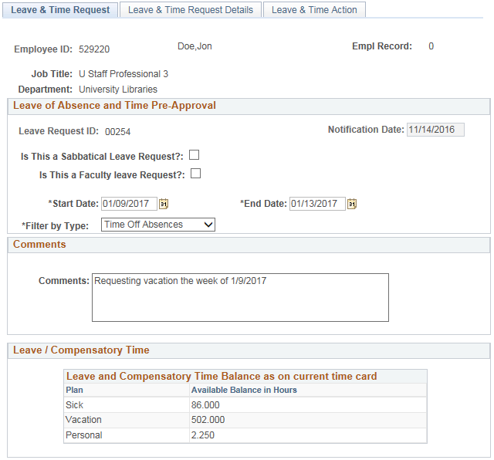
Demonstration: Submitting a Request for Vacation
Key Takeaway 1
Employees should be sure to review their current leave and compensatory time balances to confirm they have enough hours for the requested vacation, if they are time reporters.
Reminder: The available balance is as of the balance on the current timesheet. If requesting time in the future, project your hours accordingly.

Slide 7
Demonstration: Submitting a Request for Vacation
Key Takeaway 2
The Start Date and End Date should be days that you are scheduled to work that your are taking off.
For example, if you are requesting a Monday – Friday vacation, the Start Date is the first day you are not working (Monday) and the End Date is the last date you are not working (Friday).

Slide 8
Demonstration: Submitting a Request for Vacation
Key Takeaway 3
Employees can enter multiple time reporting codes on the same time request, to use their accruals as they want.
Reminder: One row of time needs to be added for each day of time off requested. Make sure that your first row and last row match the Start and End Dates on the Leave & Time Request tab.

Slide 9
Demonstration: Submitting a Request for Vacation
Key Takeaway 4
To minimize the amount of data entry on the page, employees can click Copy Down Values from First Row. This will copy all values for each day of the requested leave. The employee can then update accordingly.

Slide 10
DEMONSTRATION:
Submitting a Request for Sick Time
UConn / Core-CT HCM Integration Project
Submitting Time Off Leave Requests and Requesting to Work Overtime or Comp Time

Slide 11
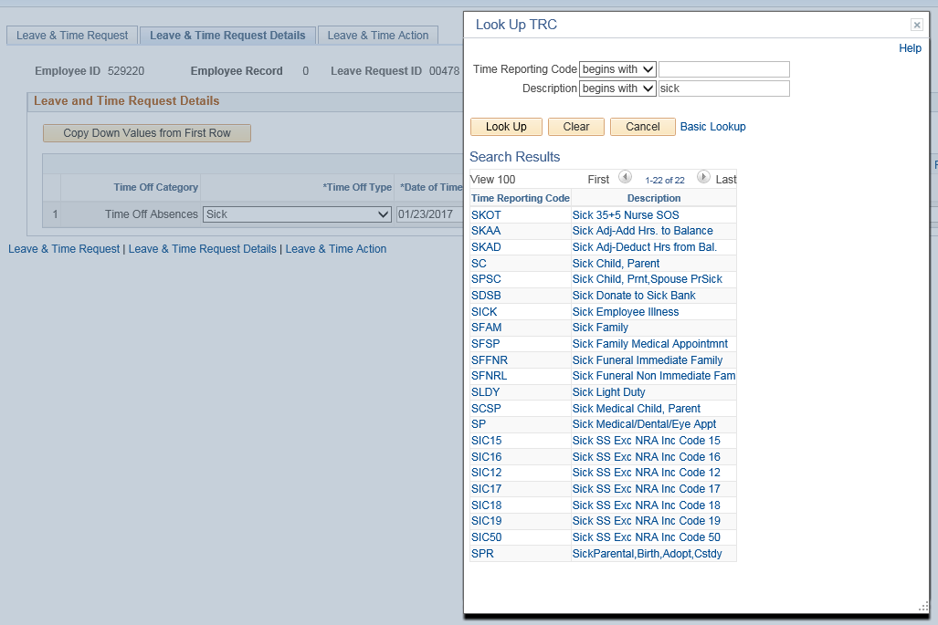
Demonstration: Submitting a Request for Sick Time
Key Takeaway 1
Use the lookup icon next to search for and select the appropriate sick Time Reporting Code.
Reminder: Requests to take time off due to medical appointments and funerals
are considered sick time.
Note: The types of sick time you are available to request off may vary based on the
type of employee you are.

Slide 12
Demonstration: Submitting a Request for Sick Time
Key Takeaway 2
FOR TIME REPORTERS ONLY
If you are requesting a partial day of time off, submit the time you are requesting off only. Note: You still need to enter time worked on your timesheet.
It is the responsibility of the employee to update their timesheet to accurately reflect the partial day taken off and the partial day worked.

Slide 13
DEMONSTRATION:
Submitting a Request to Work Overtime
or Compensatory Time
UConn / Core-CT HCM Integration Project
Submitting Time Off Leave Requests and Requesting to Work Overtime or Comp Time

Slide 14
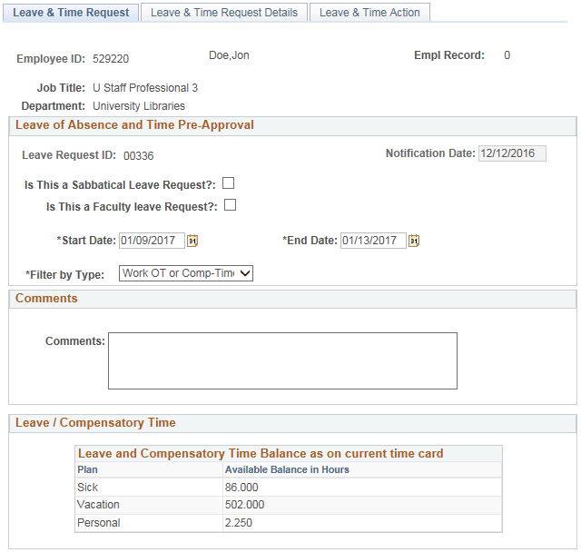
Demonstration: Submitting a Request to Work Overtime or Compensatory Time
Key Takeaway 1
Employees requesting to work overtime or compensatory time need to select the Work OT or Comp-Time option in the Filter by Type dropdown.

Slide 15
Demonstration: Submitting a Request to Work Overtime or Compensatory Time
Key Takeaway 2
Employees requesting a bulk number of hours to work overtime or compensatory time should use the Request Bulk Overtime or Comp Time section.
Examples of when to use this request option are:
If working overtime or compensatory time is frequent, but the hours are inconsistent
When working on a project and a specific month requires a significant increase in hours worked

Slide 16
Demonstration: Submitting a Request to Work Overtime or Compensatory Time
Key Takeaway 3
Employees requesting a specific, small number of hours to work overtime or compensatory time should use the Leave and Time Request Details section.
Examples of when to use this request option are:
If requesting to work more than one type of overtime and/or compensatory time on the same form
If your department’s business process is to provide a detailed request for each day the overtime and/or compensatory time request is requested

Slide 17
Agenda
Introduction
Demonstrations and Key Takeaways
Submitting a Request for Vacation
Submitting a Request for Sick Time
Submitting a Request to Work Overtime
Important Information and Resources
Question and Answers

Slide 18
Important Information and Resources
Support Labs
Leave and Time Pre-Approval Support Labs -Submitting a Time Off Leave Request, Submitting a Leave of Absence Request, Submitting a Request to Work Overtime/Comp Time, Approving a Time Off Request
Wednesday, March 29th from 9:00am-12:00pm
Brown Building, Room 103
Budds Building, Room 201C
Thursday, March 30th from 1:00pm– 4:00pm
Brown Building, Room 103
Budds Building, Room 201C
Friday, March 31st from 9:00am-12:00pm
Brown Building, Executive Conference Room
Budds Building, Room 201C
Note: These open support labs are intended to assist employees with specific questions regarding the above topics. There is no prepared presentation.

Slide 19
Important Information and Resources
Resources
Employee Self Service Website:
http://ess.uconn.edu/
Provides up-to-date details on all training offerings occurring throughout the University; not limited to the HCM Implementation Project.
Access to all self-service job aids and reference materials, as well as recorded town hall and webinar presentations, for all modules in Core-CT.

Slide 20
Agenda
Introduction
Demonstrations and Key Takeaways
Submitting a Request for Vacation
Submitting a Request for Sick Time
Submitting a Request to Work Overtime
Important Information and Resources
Question and Answers

Slide 21
Questions?
Email HCM.DataMart@uconn.edu with any additional questions.

