Slide 1
WEBINAR:
Submitting Leave of Absence Requests
UConn / Core-CT HCM Integration Project
Submitting Leave of Absence Requests

Slide 2
Agenda
Introduction
Demonstrations and Key Takeaways
Submitting a Medical/FMLA Request
Submitting a Voluntary Schedule Reduction Request
Submitting a Military Leave Request
Important Information and Resources
Question and Answers

Slide 3
Introduction
Purpose
With the implementation of the Leave and Time Pre-Approval module in Core-CT, University of Connecticut employees will be able to submit self-service requests for leaves of absence.
Objectives
To provide support, the HCM Project Training Team will employ a multi-faceted training approach for this module, including:
Webinars
Self-Service Job Aids and Reference Materials
Support Labs

Slide 4
Agenda
Introduction
Demonstrations and Key Takeaways
Submitting a Medical/FMLA Request
Submitting a Voluntary Schedule Reduction Request
Submitting a Military Leave Request
Important Information and Resources
Question and Answers

Slide 5
DEMONSTRATION:
Submitting a Medical/FMLA Request
UConn / Core-CT HCM Integration Project
Submitting Leave of Absence Requests

Slide 6
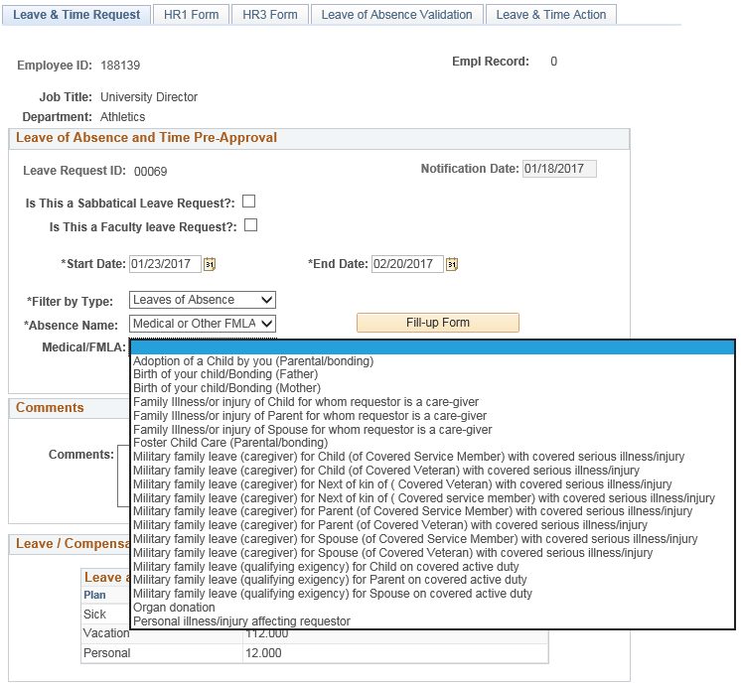
Demonstration: Submitting a Medical/FMLA Request
Key Takeaway 1
Once the Filter by Type and
Absence Name are selected for
FMLA, the employee must select a Medical/FMLA reason for the
request.
Once a reason is selected,
the Medical/FMLA leave type will auto-populate on the HR1
form.

Slide 7
Demonstration: Submitting a Medical/FMLA Request
Key Takeaway 2
There is no option for employees to upload medical notes or medical certificates on Medical/FMLA requests. However, employees will
be required to provide medical information directly to HRLA.
HRLA cannot approve a leave of absence without medical documentation.
Note: These files are not kept in the system as to keep all medical information in the strictest of confidence.

Slide 8
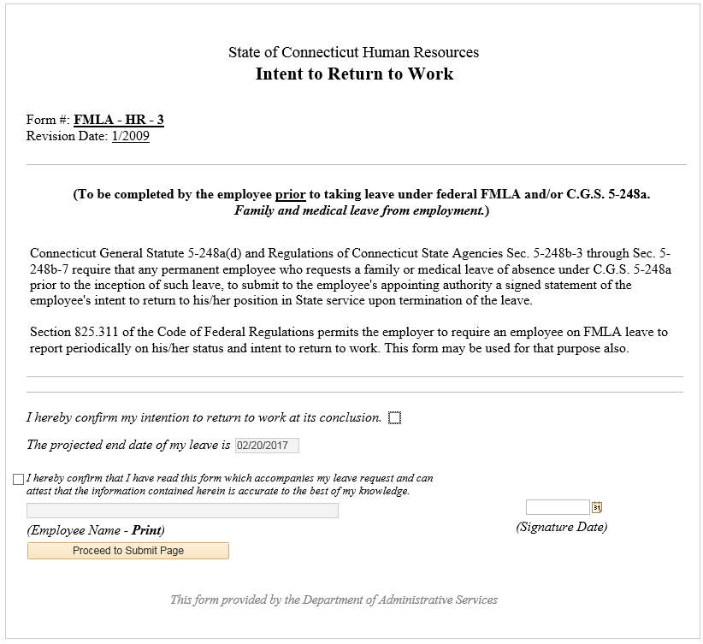
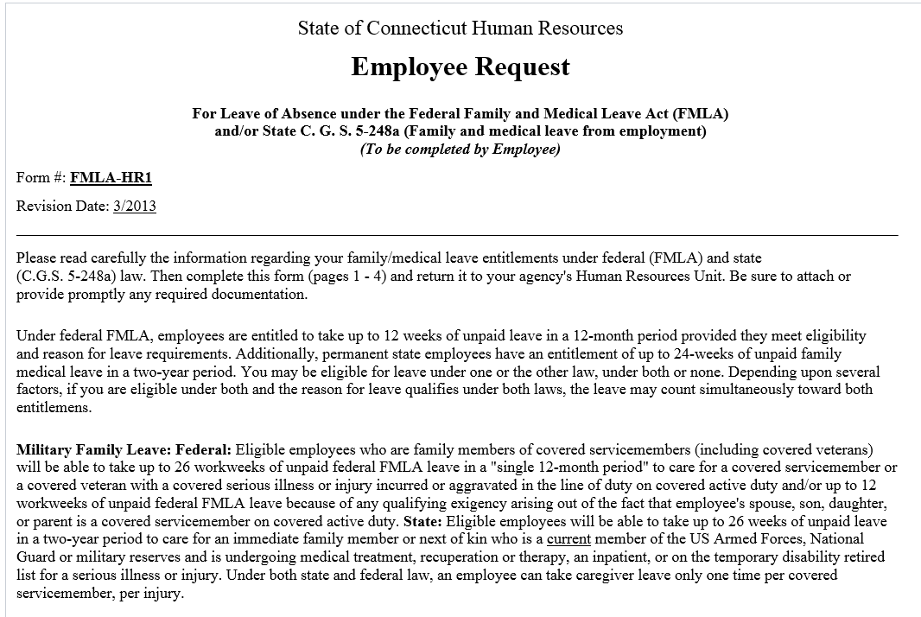
Demonstration: Submitting a Medical/FMLA Request
Key Takeaway 3
Completion of both the HR1 and HR3 forms is required prior to submitting the leave of absence request.
Note: This information is available only for the HR Leave Administrators; supervisors do not have access to this information.

Slide 9
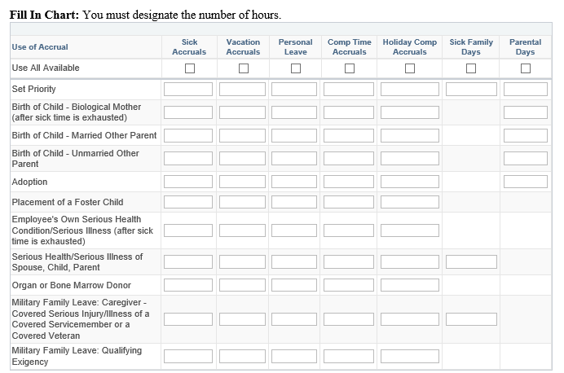
Demonstration: Submitting a Medical/FMLA Request
Key Takeaway 4
The choice to use their accruals must be made before the employee begins their leave.
If the employee elects not to use accruals, the leave will be unpaid.
If accruals are exhausted before the leave ends, the remainder of the leave will be unpaid.
Employees cannot intermingle unpaid time with paid time.

Slide 10
DEMONSTRATION:
Submitting a Voluntary Schedule Reduction Request
UConn / Core-CT HCM Integration Project
Submitting Leave of Absence Requests

Slide 11
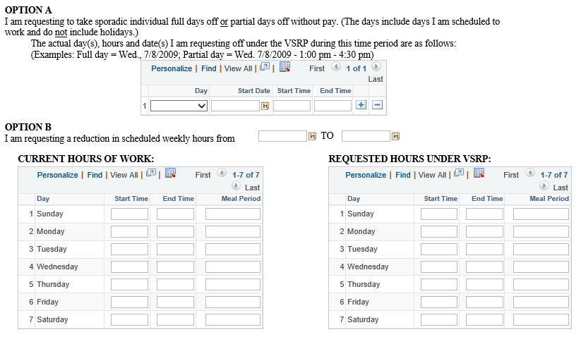
Demonstration: Submitting a Voluntary Schedule Reduction Request
Key Takeaway 1
If an employee is requesting a Voluntary Schedule Reduction over two fiscal years, two separate requests will need to be submitted.

Slide 12
Demonstration: Submitting a Voluntary Schedule Reduction Request
Key Takeaway 2
On the Voluntary Schedule Reduction Program (VSRP) form, employees must designate if the request is for:
Sporadic Days Off
Reduction in scheduled weekly hours
Leave of absence (5 consecutive days or more)

Slide 13
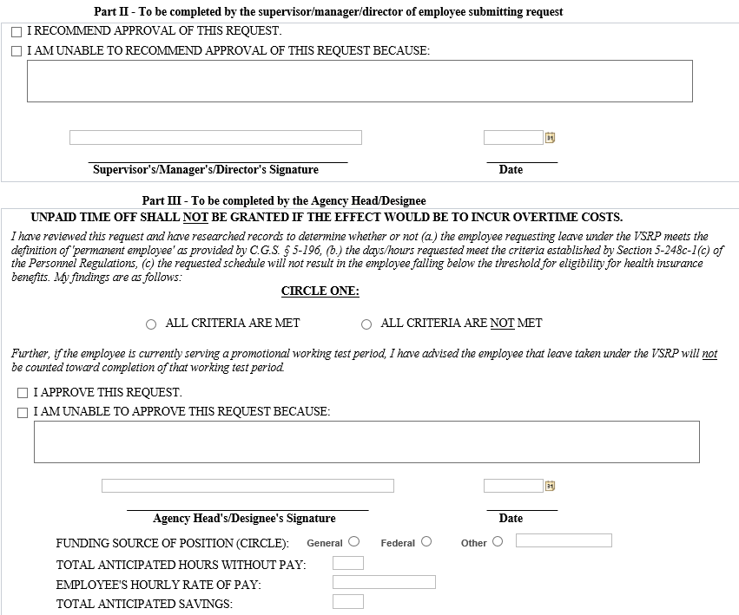
Demonstration: Submitting a Voluntary Schedule Reduction Request
Key Takeaway 3
Once the request is submitted by the employee, the Voluntary Schedule Reduction Program (VSRP) form is routed to the employee’s Supervisor, Department Head and Dean/Director for approval, before being finalized by Human Resources.

Slide 14
DEMONSTRATION:
Submitting a Military Leave Request
UConn / Core-CT HCM Integration Project
Submitting Leave of Absence Requests

Slide 15
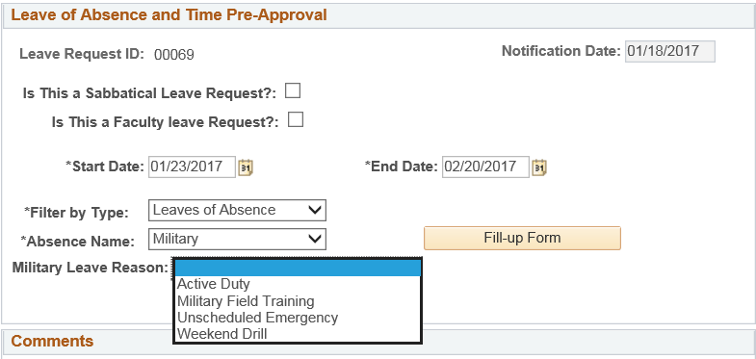
Demonstration: Submitting a Military Leave Request
Key Takeaway 1
On the Leave & Time Request form, the employee must select the Military Leave Reason to identify the reason for the request.

Slide 16
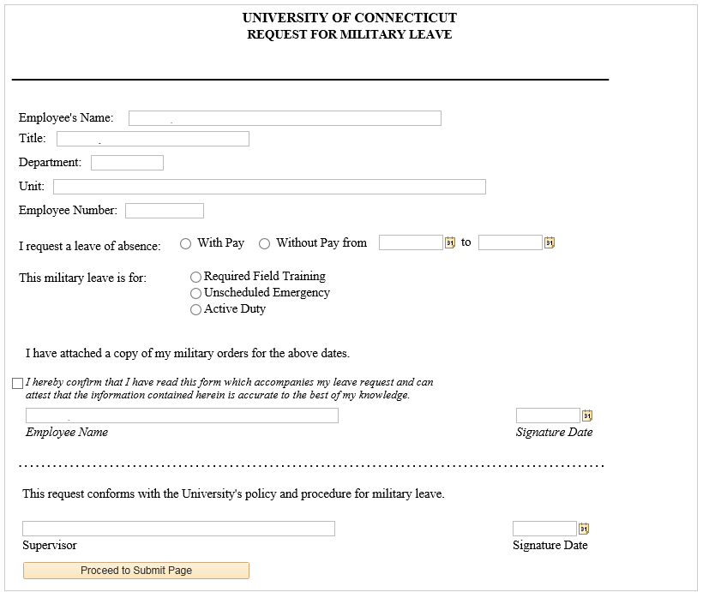
Demonstration: Submitting a Military Leave Request
Key Takeaway 2
A copy of the military orders must be attached to the military leave request form confirming the start and end dates of the leave.

Slide 17
Agenda
Introduction
Demonstrations and Key Takeaways
Submitting a FMLA Request
Submitting a Voluntary Schedule Reduction Request
Submitting a Military Leave Request
Important Information and Resources
Question and Answers

Slide 18
Important Information and Resources
Support Labs
Leave and Time Pre-Approval Support Labs -Submitting a Time Off Leave Request, Submitting a Leave of Absence Request, Submitting a Request to Work Overtime/Comp Time, Approving a Time Off Request
Wednesday, March 29th from 9:00am-12:00pm
Brown Building, Room 103
Budds Building, Room 201C
Thursday, March 30th from 1:00pm– 4:00pm
Brown Building, Room 103
Budds Building, Room 201C
Friday, March 31st from 9:00am-12:00pm
Brown Building, Executive Conference Room
Budds Building, Room 201C
Note: These open support labs are intended to assist employees with specific questions regarding the above topics. There is no prepared presentation.

Slide 19
Important Information and Resources
Resources
Employee Self Service Website:
http://ess.uconn.edu/
Provides up-to-date details on all training offerings occurring throughout the University; not limited to the HCM Implementation Project.
Access to all self-service job aids and reference materials, as well as recorded town hall and webinar presentations, for all modules in Core-CT.

Slide 20
Agenda
Introduction
Demonstrations and Key Takeaways
Submitting a FMLA Request
Submitting a Voluntary Schedule Reduction Request
Submitting a Military Leave Request
Important Information and Resources
Question and Answers

Slide 21
Questions?
Email HCM.DataMart@uconn.edu with any additional questions.

