Slide 1
WEBINAR:
Submitting Benefits Elections
due to a Life Event
UConn / Core-CT HCM Integration Project
Submitting Benefits Elections
due to a Life Event

Slide 2
Agenda
Introduction
Demonstrations and Key Takeaways
Birth/Adoption Life Event
Divorce Life Event
Loss of Coverage Life Event
Important Information and Resources
Question and Answers

Slide 3
Introduction
Purpose
With the implementation of the eBenefits module in Core-CT, University of Connecticut employees will be able to submit self-service benefits updates when a life qualifying life event occurs.
Objectives
To provide support, the HCM Project Training Team will employ a multi-faceted training approach for this module, including:
Self-Service Job Aids and Reference Materials
Webinars
Support Labs

Slide 4
Introduction: eBenefits
Before You Begin a Life Event:
Family Less Employed Spouse (FLES): If you and your spouse are both State of Connecticut employees and you have at least one eligible dependent, you must contact your Agency Benefits Specialist for assistance in enrolling in or changing to the Family Less Employed Spouse (FLES) options. FLES elections cannot be processed through self-service.
Proof Documentation: Employees are required to provide proof documentation for life events. Employees have the ability to electronically upload the proof documentation in Core-CT. If the employee chooses to not electronically upload the documentation, they need to add notes on the attachments page and explain how they will provide proof.
Social Security Number: You will be asked to provide the Social Security Number for any dependent(s) you are adding to coverage (spouse and any stepchildren).
Dependent Eligibility: For medical, dependents are eligible until age 26, dental, children are eligible until age 19. If you are enrolling disabled children, you cannot use eBenefits. You have to contact your Agency Benefits Specialist.
Review Your Dependents/Beneficiaries: Before starting a life event, review your current list of dependents and beneficiaries in Core-CT. You are only permitted to enroll a spouse and children (and stepchildren) to your benefits. If the relationship listed for any of your current dependents or beneficiaries is anything other than spouse, child, or stepchild, you will not be able to enroll them in eBenefits. To change the relationship to spouse, child or stepchild, contact your Agency Benefits Specialist to update their information prior to starting the life event.

Slide 5
Agenda
Introduction
Demonstrations and Key Takeaways
Birth/Adoption Life Event
Divorce/Legal Separation Life Event
Loss of Coverage Life Event
Important Information and Resources
Question and Answers

Slide 6
DEMONSTRATION:
Birth/Adoption Life Event
UConn / Core-CT HCM Integration Project
Submitting Benefit Elections due to a Life Event

Slide 7
Demonstration: Birth/Adoption Life Event
Key Takeaway 1
Proof documents are required when updating your benefits due to a birth or adoption of a child. Employees can upload using document upload feature in Core-CT. Proof documents can include: Birth Certificate, Adoption Decree, and Notification of Placement of Adoption.

Slide 8
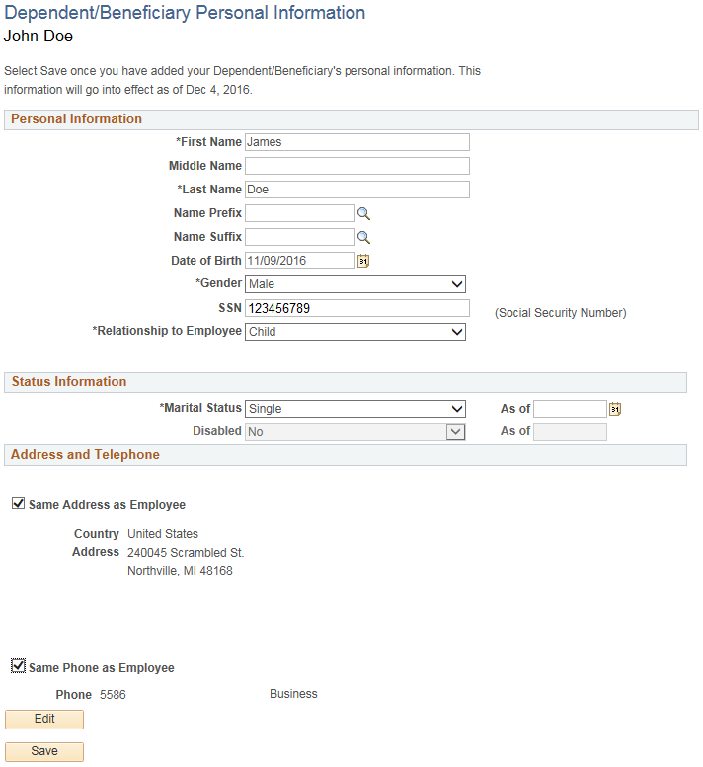
Demonstration: Birth/Adoption Life Event
Key Takeaway 2
Information that is entered and saved about the new dependent may not be edited by the employee after submission.
Changes must be requested by the employee through their Agency Benefit Specialist. Employees must ensure they have entered all information, including gender, correctly.

Slide 9
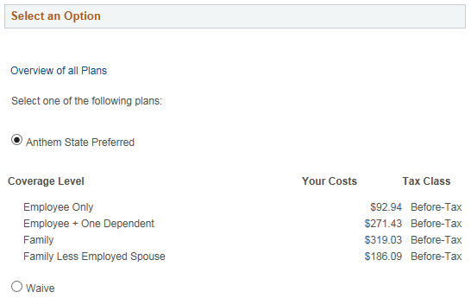
Demonstration: Birth/Adoption Life Event
Key Takeaway 3
None of your benefit elections will become effective until it is approved by your Agency Benefits Specialist.

Slide 10
DEMONSTRATION:
Divorce/Legal Separation Life Event
[link to environment]
UConn / Core-CT HCM Integration Project
Submitting Benefits Elections due to a Life Event

Slide 11
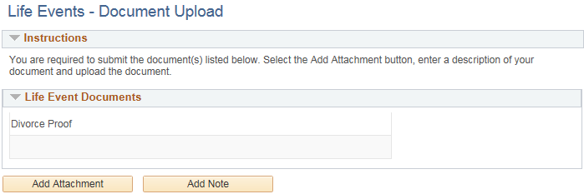
Demonstration: Divorce/Legal Separation Life Event
Key Takeaway 1
Proof of Divorce and Proof of Legal Separation can include a screen print proclaiming the divorce from the State of Connecticut Judicial website.
If your divorce was filed in a different state, you can include a screen print from that state’s judicial website.

Slide 12
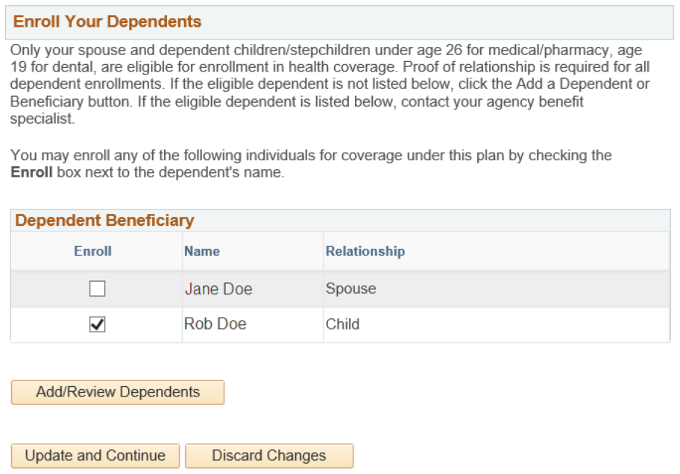
Demonstration: Divorce/Legal Separation Life Event
Key Takeaway 2
In addition to removing your ex-spouse from coverage, you must also remove stepchildren.
Uncheck the Enroll box next to each name to remove the spouse and stepchildren from coverage.
If left checked, the Benefits Specialist will verify if the dependent(s) should be removed.

Slide 13
DEMONSTRATION:
Loss of Coverage Life Event
[link to environment]
UConn / Core-CT HCM Integration Project
Submitting Benefits Elections due to a Life Event

Slide 14
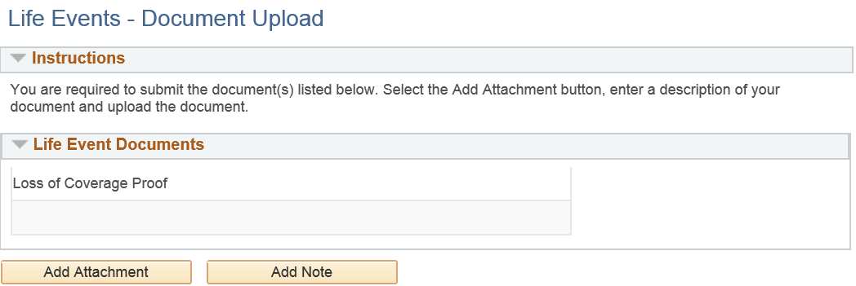
Demonstration: Loss of Coverage Life Event
Key Takeaway 1
For a loss of coverage event, proof of loss of coverage is required. This includes: letter from employer stating loss of coverage, COBRA notice. Any eligible dependents the employee wishes to enroll, must be listed on the loss of coverage document.
If enrolling eligible dependents to coverage, you must also provide your relationship proof document(s) here, including: Marriage Certificate, Birth Certificate(s)

Slide 15
Agenda
Introduction
Demonstrations and Key Takeaways
Birth/Adoption Life Event
Divorce Life Event
Loss of Coverage Life Event
Important Information and Resources
Question and Answers

Slide 16
Important Information and Resources
Resources
Employee Self Service Website:
http://ess.uconn.edu/
Provides up-to-date details on all training offerings occurring throughout the University; not limited to the HCM Implementation Project.
Access to all self-service job aids and reference materials, as well as recorded town hall and webinar presentations, for all modules in Core-CT.

Slide 17
Agenda
Introduction
Demonstrations and Key Takeaways
Birth/Adoption Life Event
Divorce Life Event
Loss of Coverage Life Event
Important Information and Resources
Question and Answers

Slide 18
Questions?
Email HCM.DataMart@uconn.edu with any additional questions.

