Slide 4
HCM Project Overview

Slide 5
HCM Project Overview

Slide 8
HCM Project: Scope

Slide 9
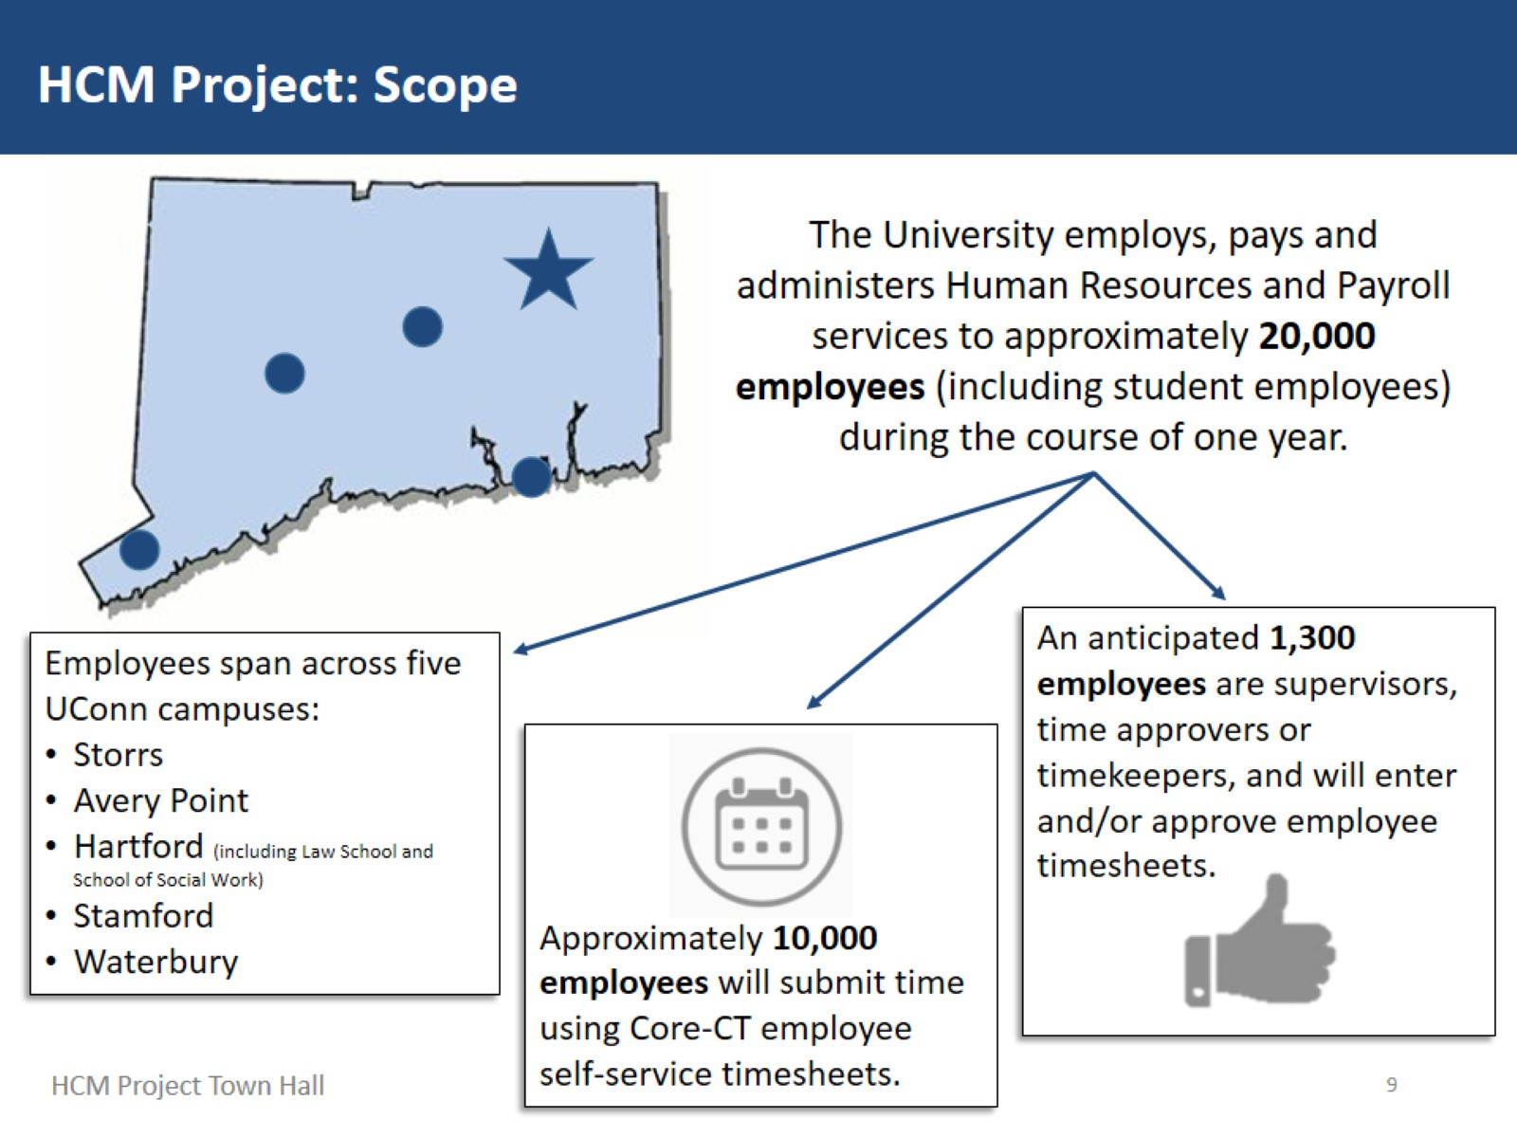

Slide 10
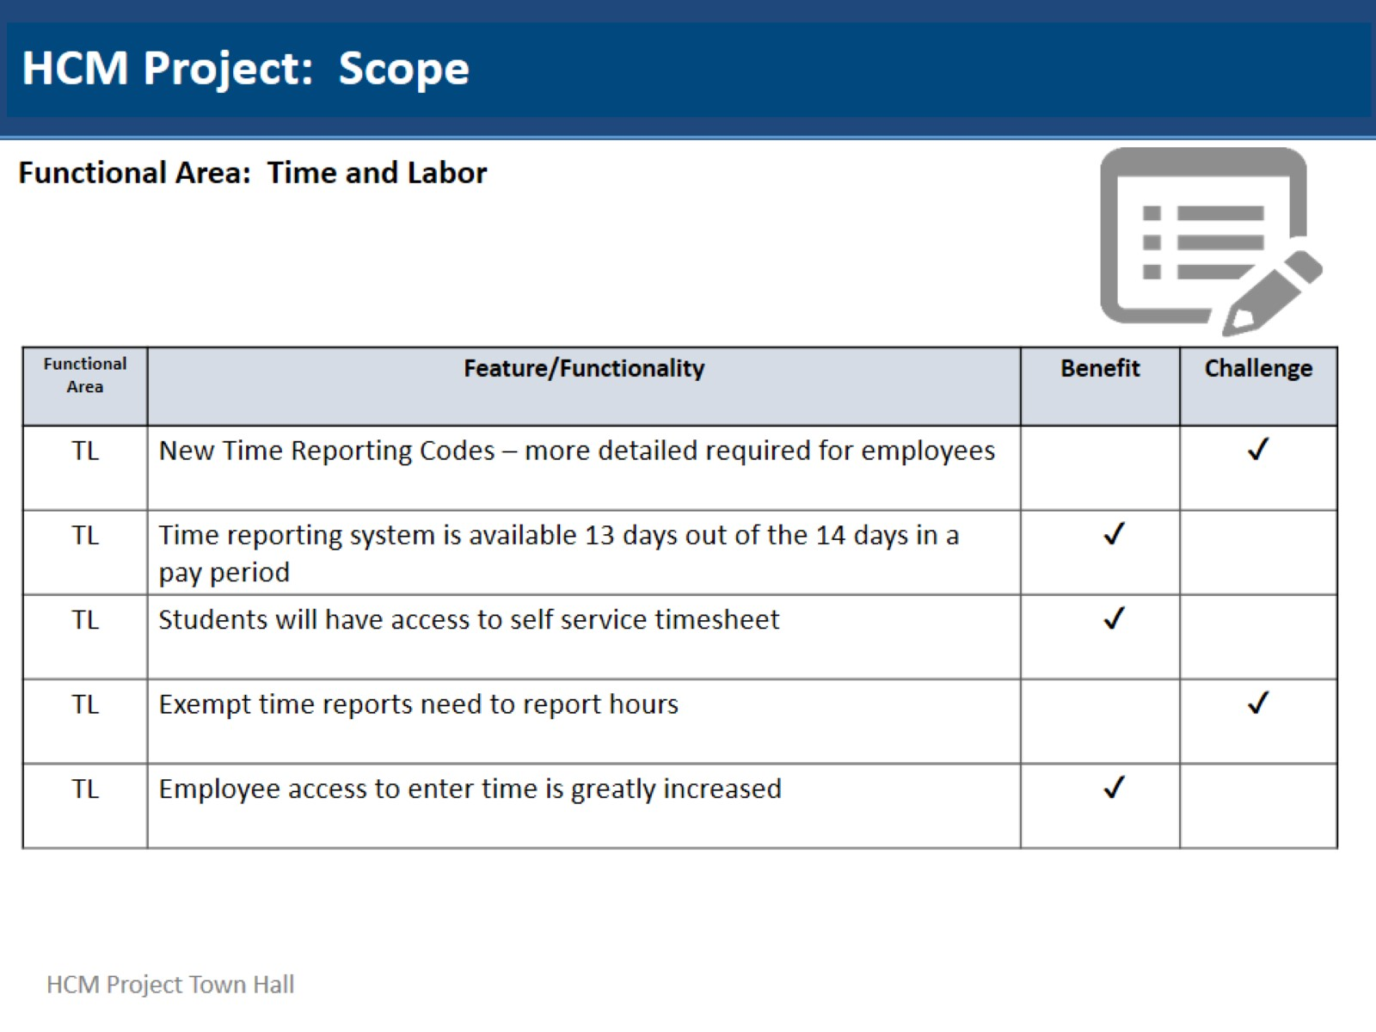
HCM Project: Scope

Slide 11
HCM Project: Scope

Slide 14
HCM Project: Upcoming Events / Communications*

Slide 15
HCM Project: Upcoming Events / Communications*

Slide 16
HCM Project: Upcoming Events / Communications

Slide 17
HCM Project: Upcoming Events / Communications

